Slide 1
Descriptive statistics
Describing data with numbers:
measures of location

Slide 2
What to describe?
What is the “location” or “center” of the data? (“measures of location”)

Slide 3
Measures of Location
Measures of location describe the position of one score relative to the others rather than the whole set of data. Measures how an item fits into the data, how it compares to other items of the data, or even how it compares to another item in another data set.
Mean
Median
Mode

Slide 4
Measures of Central Tendency
Measures of central tendency yield information about “particular places or locations in a group of numbers.” Each of these measures describes a different indication of the typical or central value in the distribution.
  Median
  Mean
  Mode

Slide 5
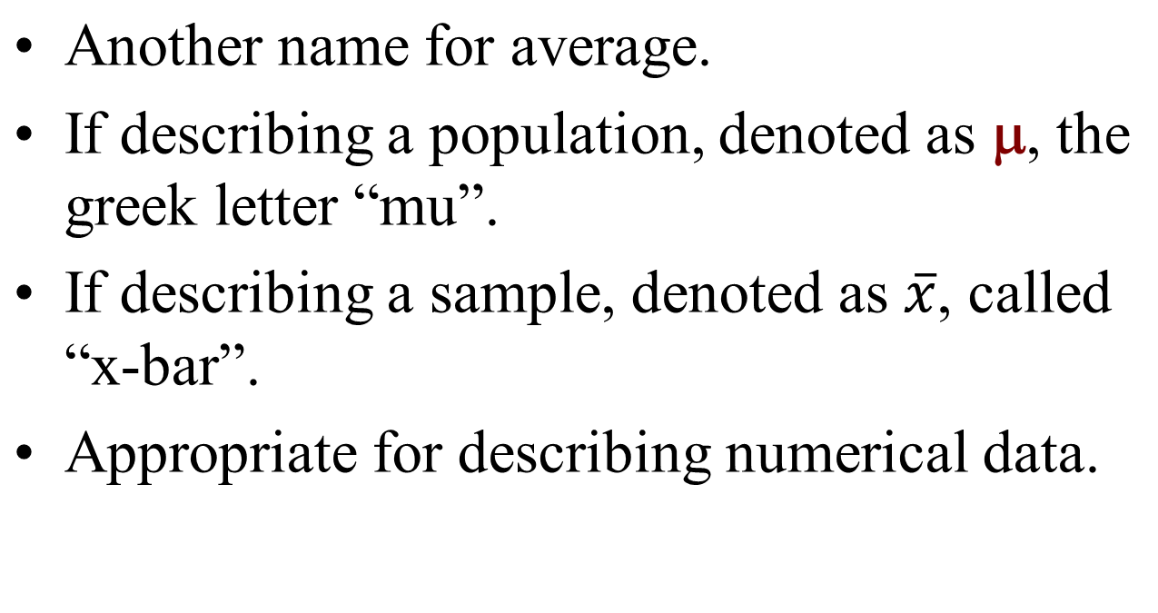
Mean

Slide 6
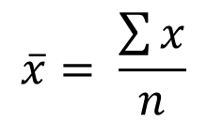
Calculating Sample Mean
Formula:
That is, add up all of the data points and divide by the number of data points.
Data (# of classes skipped): 2 8 3 4 1
Do not round! Mean need not be a whole number.

Slide 7
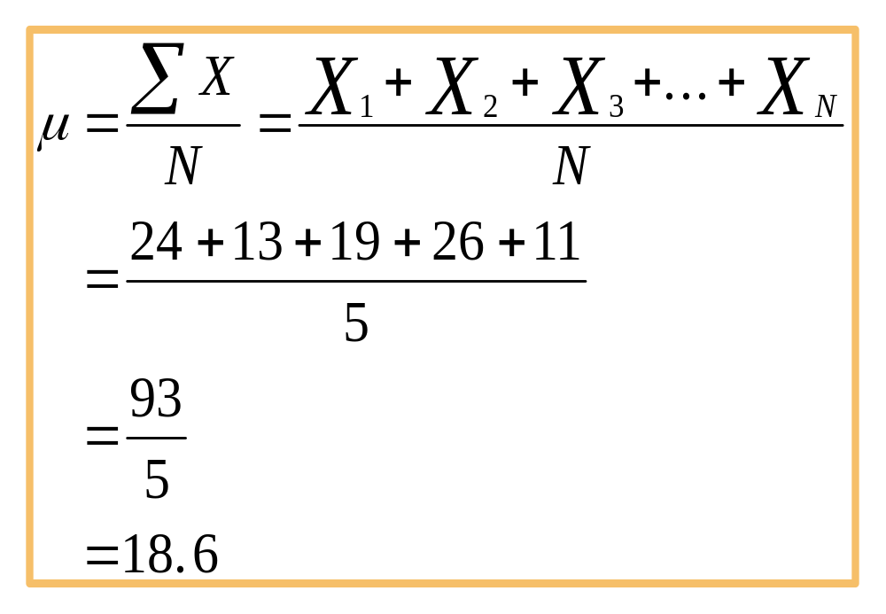
Calculating Population Mean

Slide 8
Median
Another name for 50th percentile.
Appropriate for describing numerical data.
“Robust to outliers,” that is, not affected much by unusual values.

Slide 9
Calculating Median
Order data from smallest to largest.
If odd number of data points, the median is the middle value.
Data (# of classes skipped): 2 8 3 4 1
Ordered Data: 1 2 3 4 8
Median

Slide 10
Calculating Median
Order data from smallest to largest.
If even number of data points, the median is the average of the two middle values.
Data (# of classes skipped): 2 8 3 4 1 8
Ordered Data: 1 2 3 4 8 8
Median = (3+4)/2 = 3.5

Slide 11
Mode
The value that occurs most frequently.
One data set can have many modes.
Appropriate for all types of data, but most useful for categorical data or discrete data with only a few number of possible values.

Slide 12
Measures of Shape
Skewness
  Absence of symmetry
  Extreme values in one side of a distribution

Slide 13
Distribution Shape: Skewness
Symmetric (not skewed)
  Skewness is zero.
  Mean and median are equal.
Skewness = 0
.35
.30
.25
.20
Relative Frequency
.15
.10
.05
0

Slide 14
Distribution Shape: Skewness
Moderately Skewed Left
  Skewness is negative.
  Mean will usually be less than the median.
Skewness = − .31
.35
.30
.25
.20
Relative Frequency
.15
.10
.05
0

Slide 15
Distribution Shape: Skewness
Moderately Skewed Right
  Skewness is positive.
  Mean will usually be more than the median.
Skewness = .31
.35
.30
.25
.20
Relative Frequency
.15
.10
.05
0

Slide 16
Distribution Shape: Skewness
Highly Skewed Right
  Skewness is positive (often above 1.0).
  Mean will usually be more than the median.
Skewness = 1.25
.35
.30
.25
.20
Relative Frequency
.15
.10
.05
0

Slide 17
Skewness
Negatively
Skewed
Symmetric
(Not Skewed)
Positively
Skewed

Slide 18
Skewness
Mean
Mode
Mean
Median
Mode
Mode
Mean
Median
Median
Negatively
Skewed
Symmetric
(Not Skewed)
Positively
Skewed

Slide 19
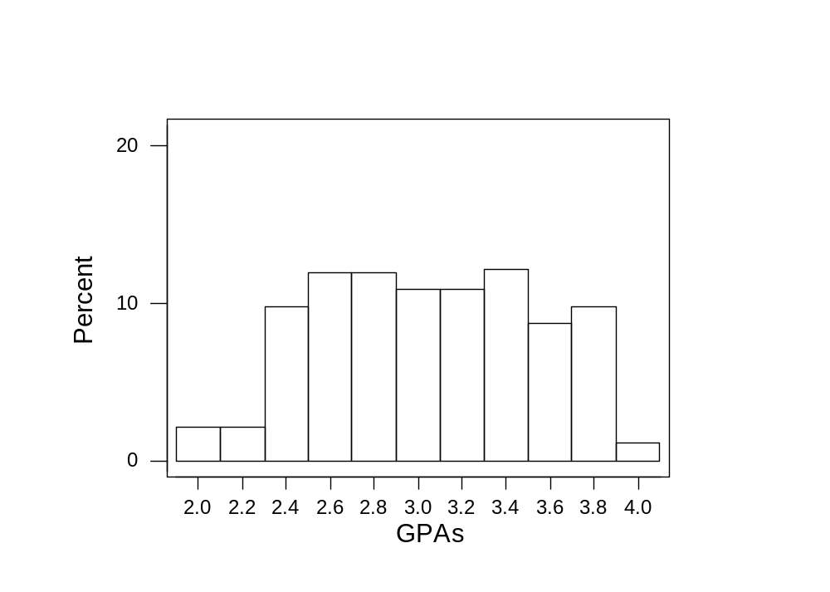
Symmetric and Unimodal

Slide 20
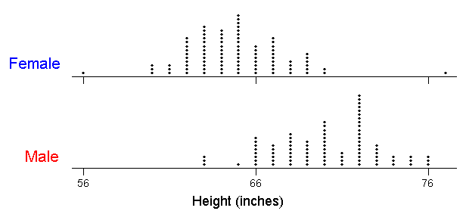
Symmetric and Bimodal

Slide 21
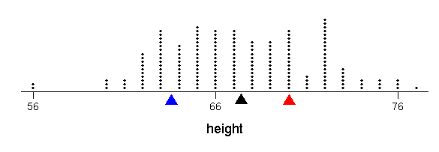
Symmetric and Bimodal

Slide 22
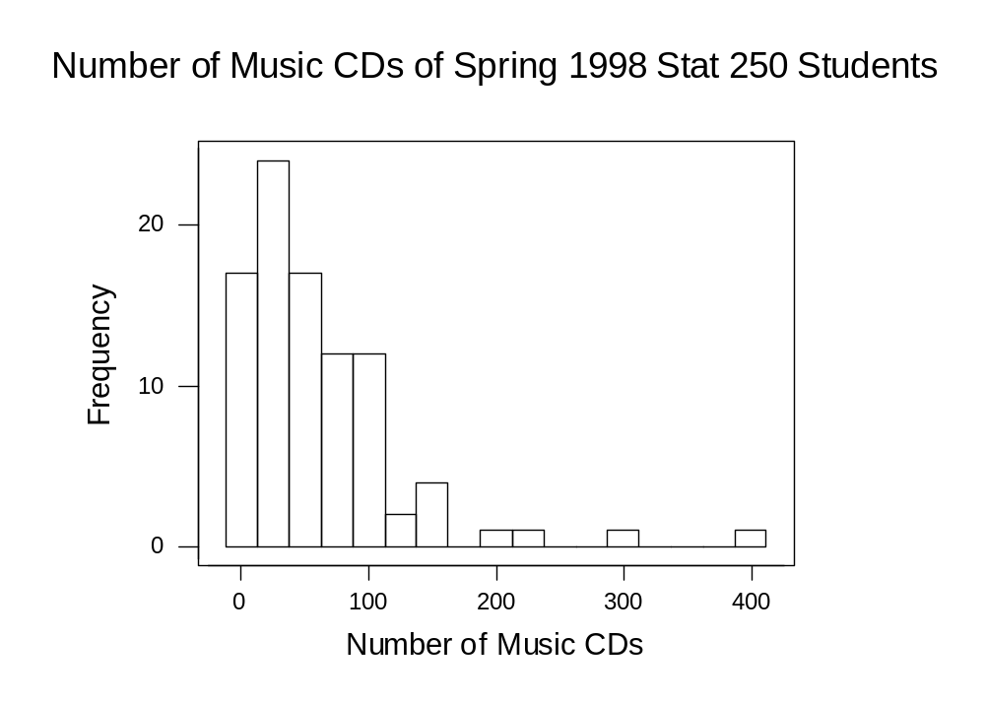
Skewed Right

Slide 23
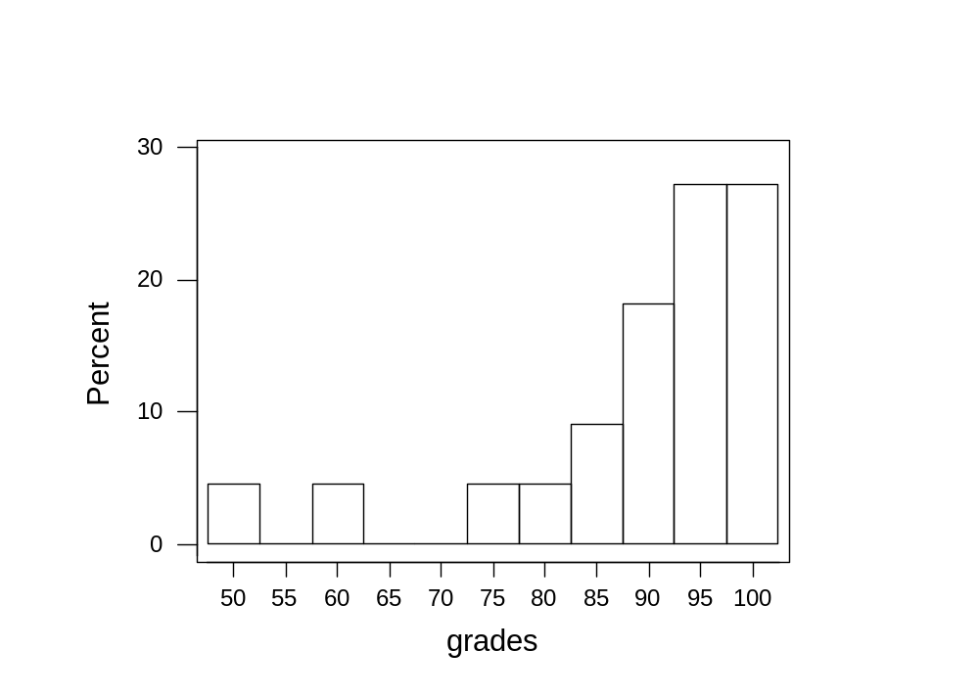
Skewed Left

